Slide 1
CSS3 Using JavaScript
CIT 261
Ryan Dockstader

Slide 2
Ways of manipulating CSS in JS
Adding Classes
Removing Classes
Manipulating the style directly

Slide 3

Adding Classes
Once you have the element you can access the class array via the .classList property
You can then simply use .add() to add another class

Slide 4

Removing a Class
Removing a class is basically the same as adding a class:

Slide 5
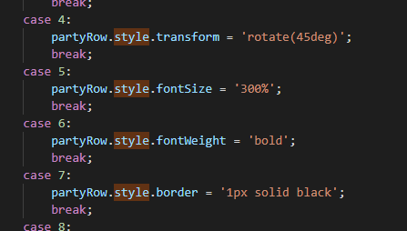
Manipulating the style directly (add)
You can also access the Style attribute directly on the element, which contains all the properties that you can set via CSS
Anything that contains a dash (I.e. background-color) becomes camel case (I.E. backgroundColor)

Slide 6


Manipulating the style directly (remove)
Removing the style property is as simple as setting it to an empty string
Removing all the style uses the removeAttribute() function on the elment

